Slide 1

Mobile App
Our Team:
Suman Devkota
Navina Budhathoki
Arpan Pokhrel

Slide 2
KinMel
KinMel, the best place to shop online without any hassles.
At KinMel, prioritizing security: email and payment verification ensure a safe shopping environment.
Utilizing performance optimization strategies for lightning-fast page loads, ensuring a seamless shopping journey.

Slide 3
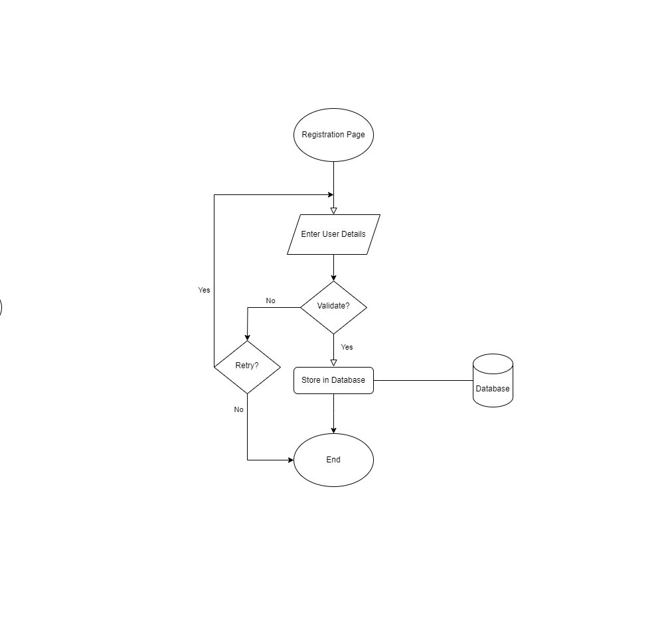
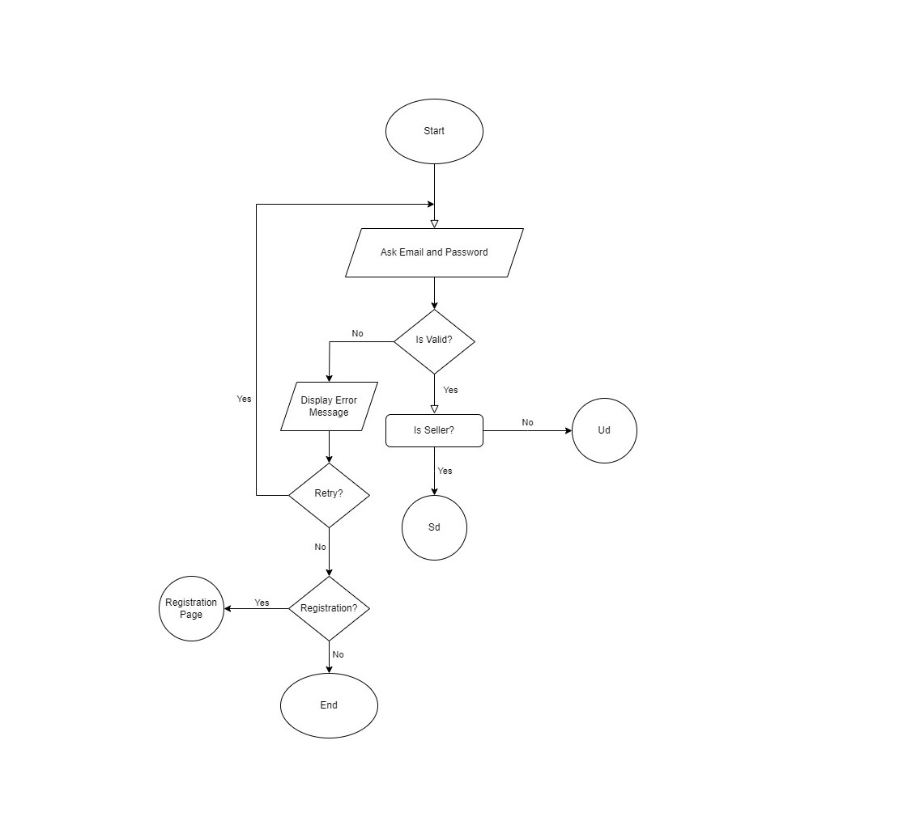
Flowchart
Flowchart
Flowchart

Slide 4
Fig: Flowchart (Registration)

Slide 5
Fig: Flowchart (Login)

Slide 6
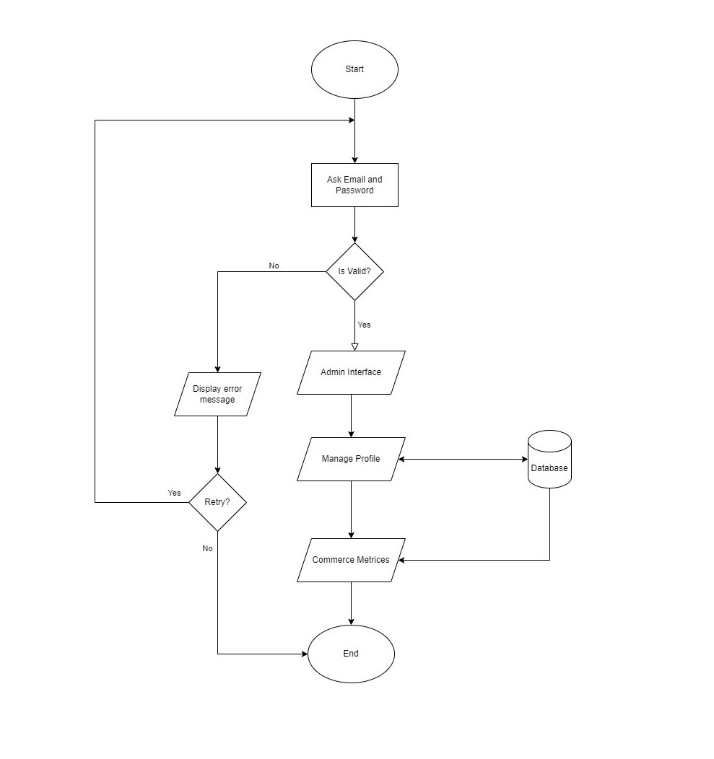
Fig: Flowchart (Admin)

Slide 7
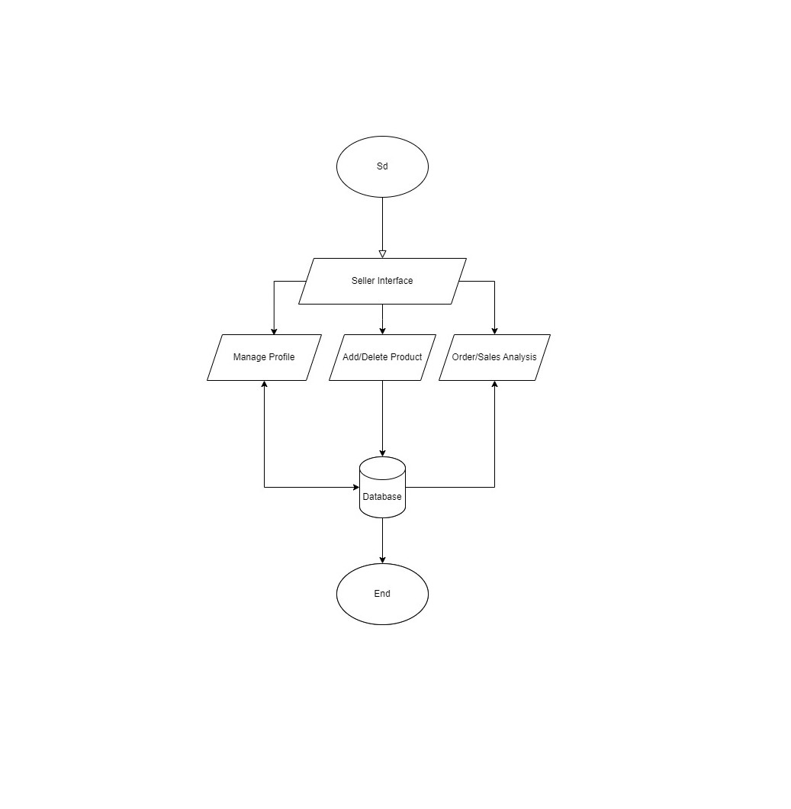
Fig: Flowchart (Seller)

Slide 8
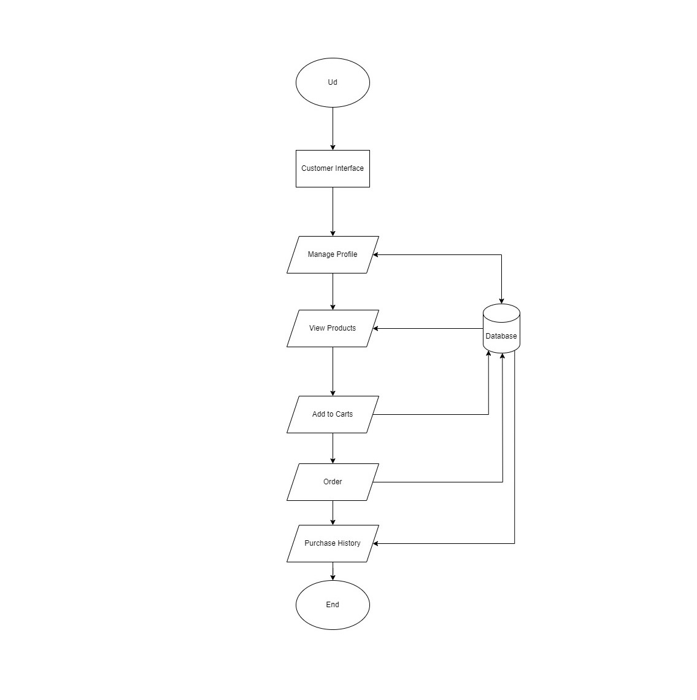
Fig: Flowchart (Buyer)

Slide 9
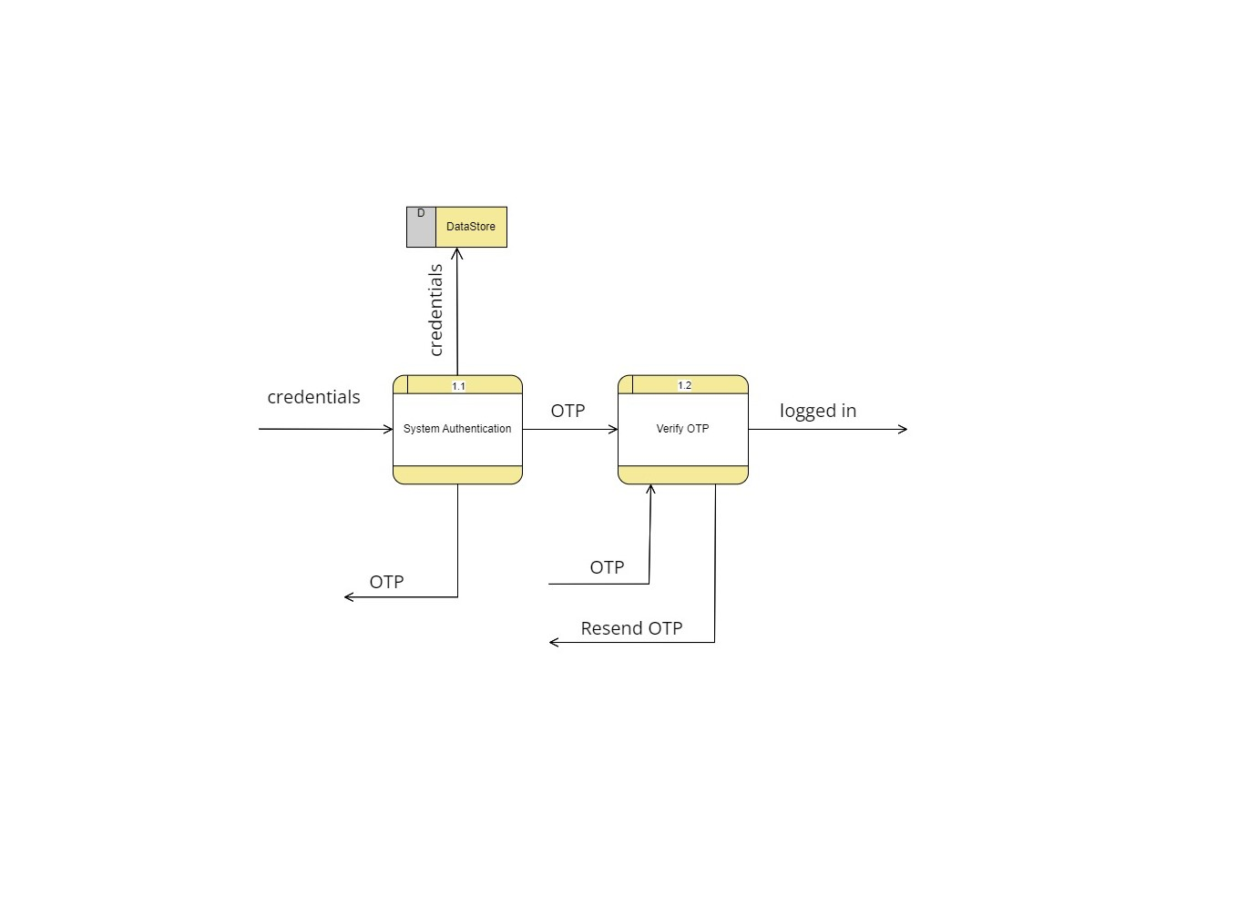
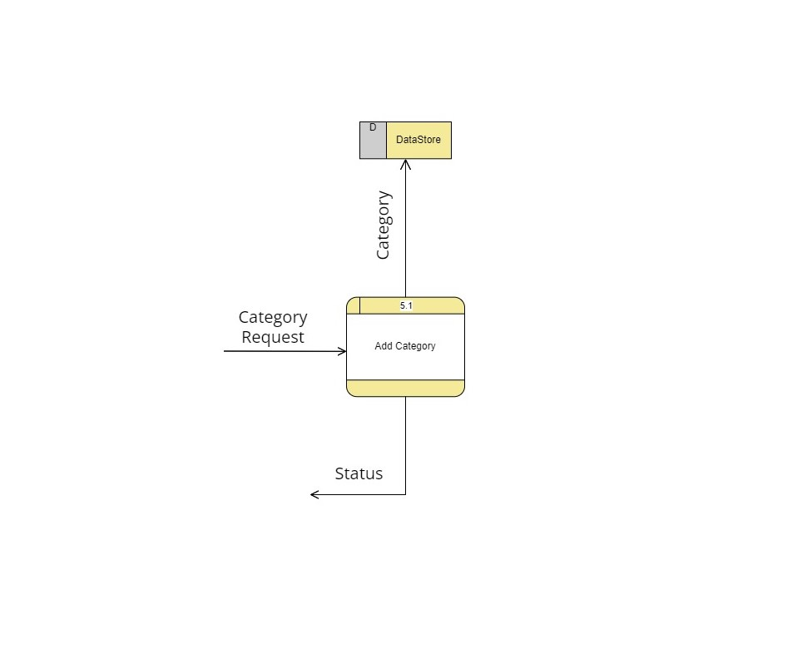
Data Flow Diagram
DFD-1
DFD-0

Slide 10
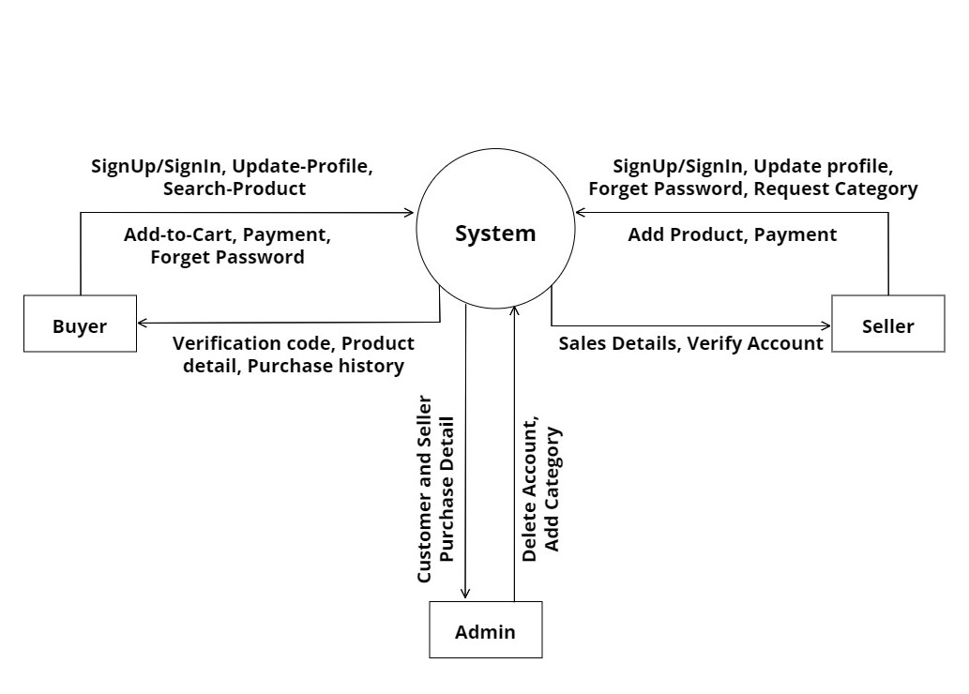
Fig: DFD Level-0

Slide 11
Fig: DFD Level-1(Authentication)

Slide 12
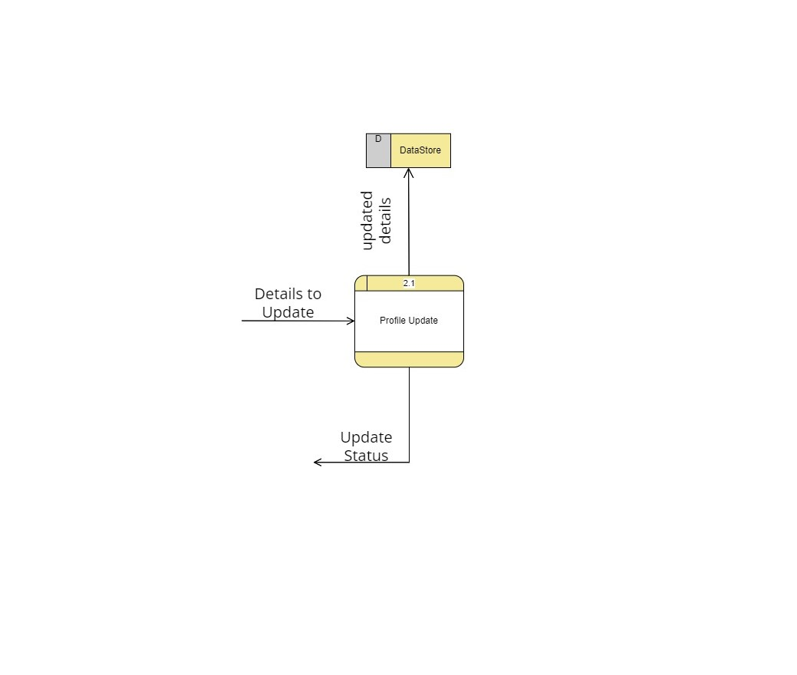
Fig: DFD Level-1(Manage Profile)

Slide 13
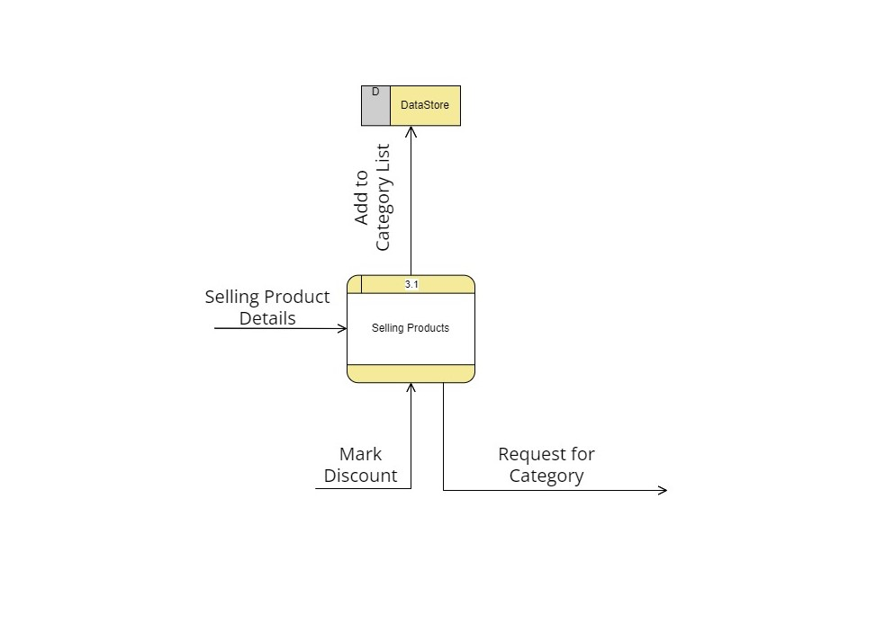
Fig: DFD Level-1(Add Products)

Slide 14
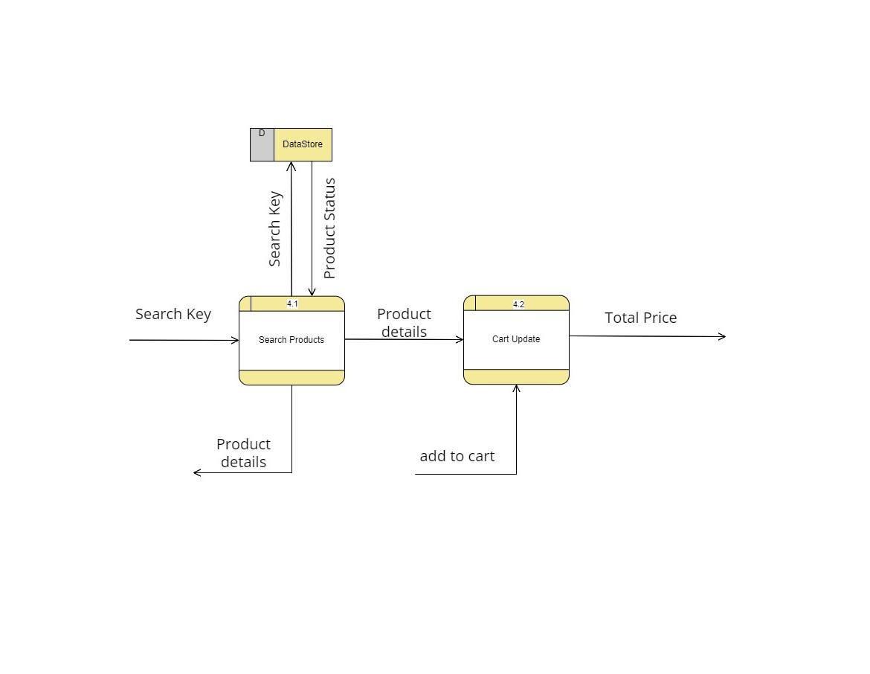
Fig: DFD Level-1(Add to Cart)

Slide 15
Fig: DFD Level-1(Request Category)

Slide 16
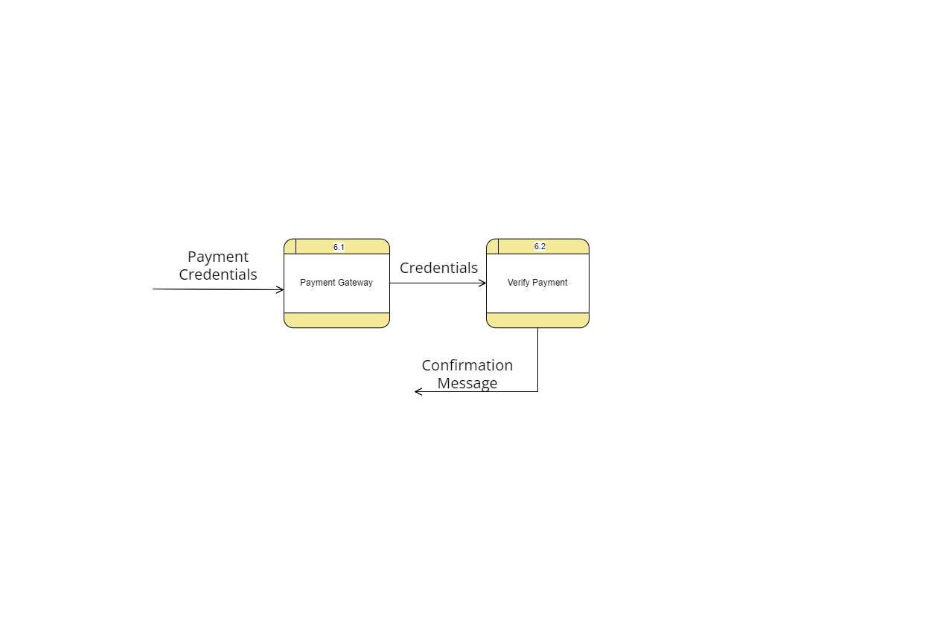
Fig: DFD Level-1(Payment)

Slide 17
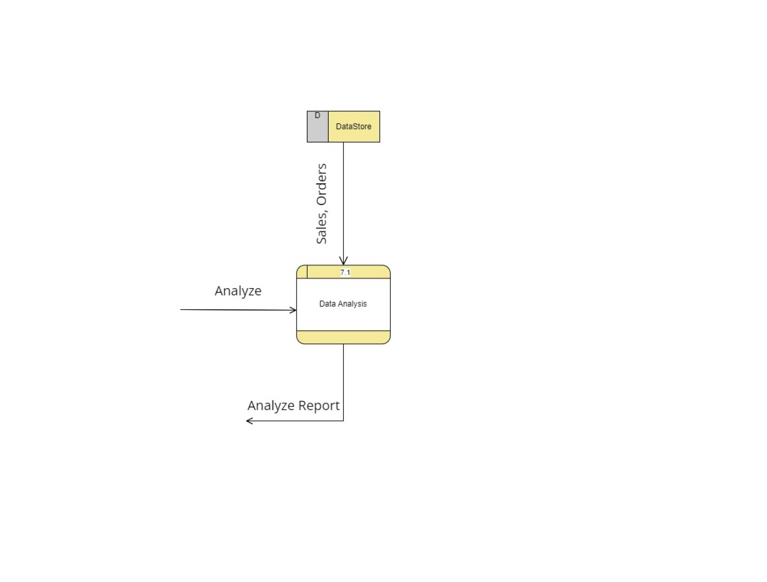
Fig: DFD Level-1(Analysis)

Slide 18
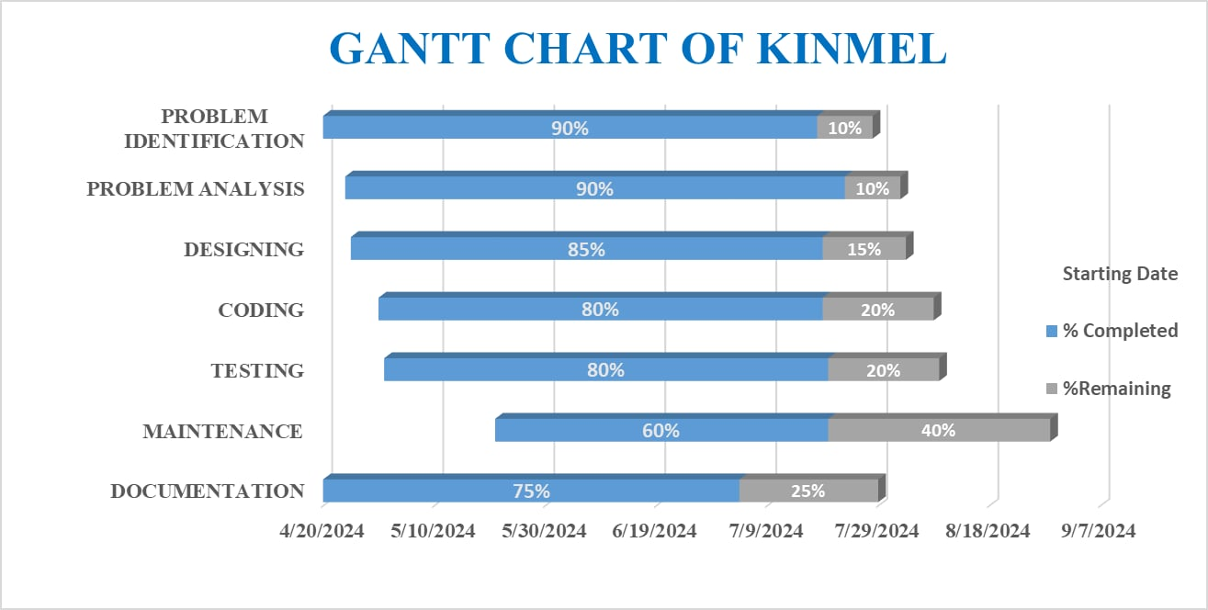
Fig: GANTT CHART

Slide 19
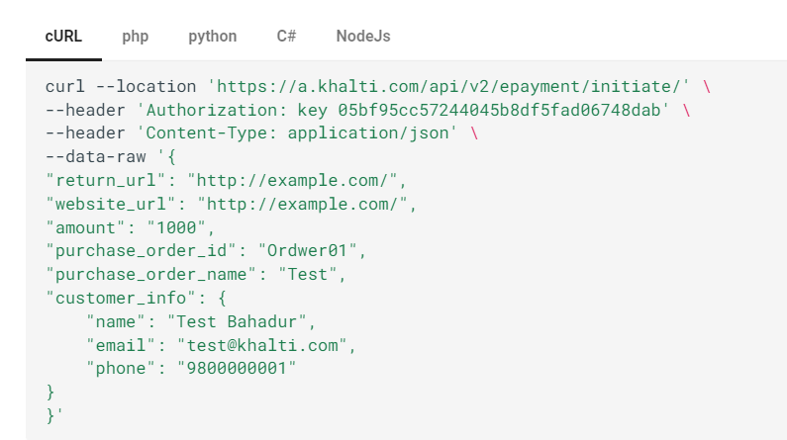
Fig:Bottleneck

Slide 20
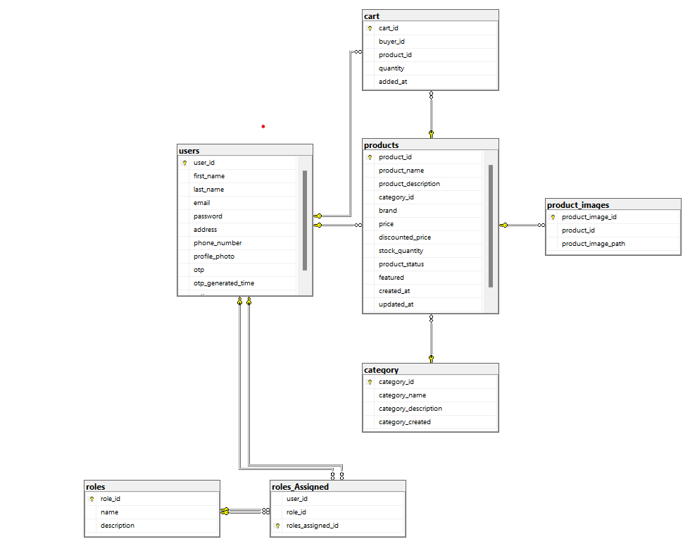
Fig: Database Schema

Slide 21
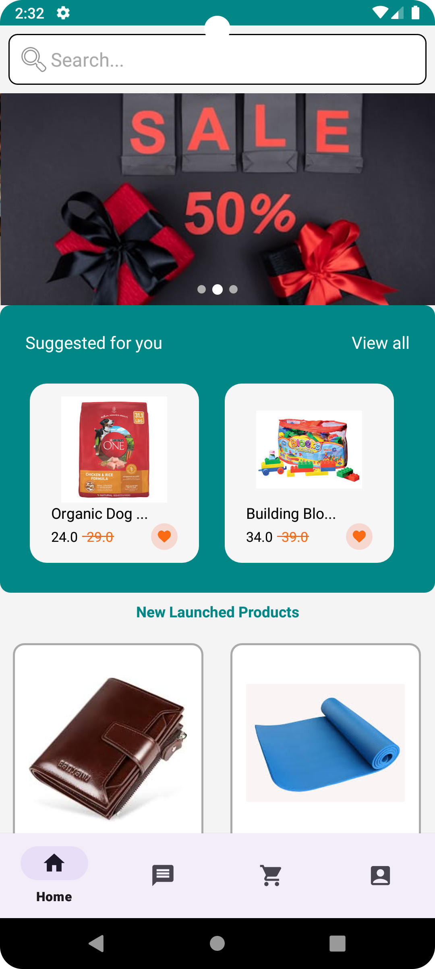
Demo
Demo

Slide 22
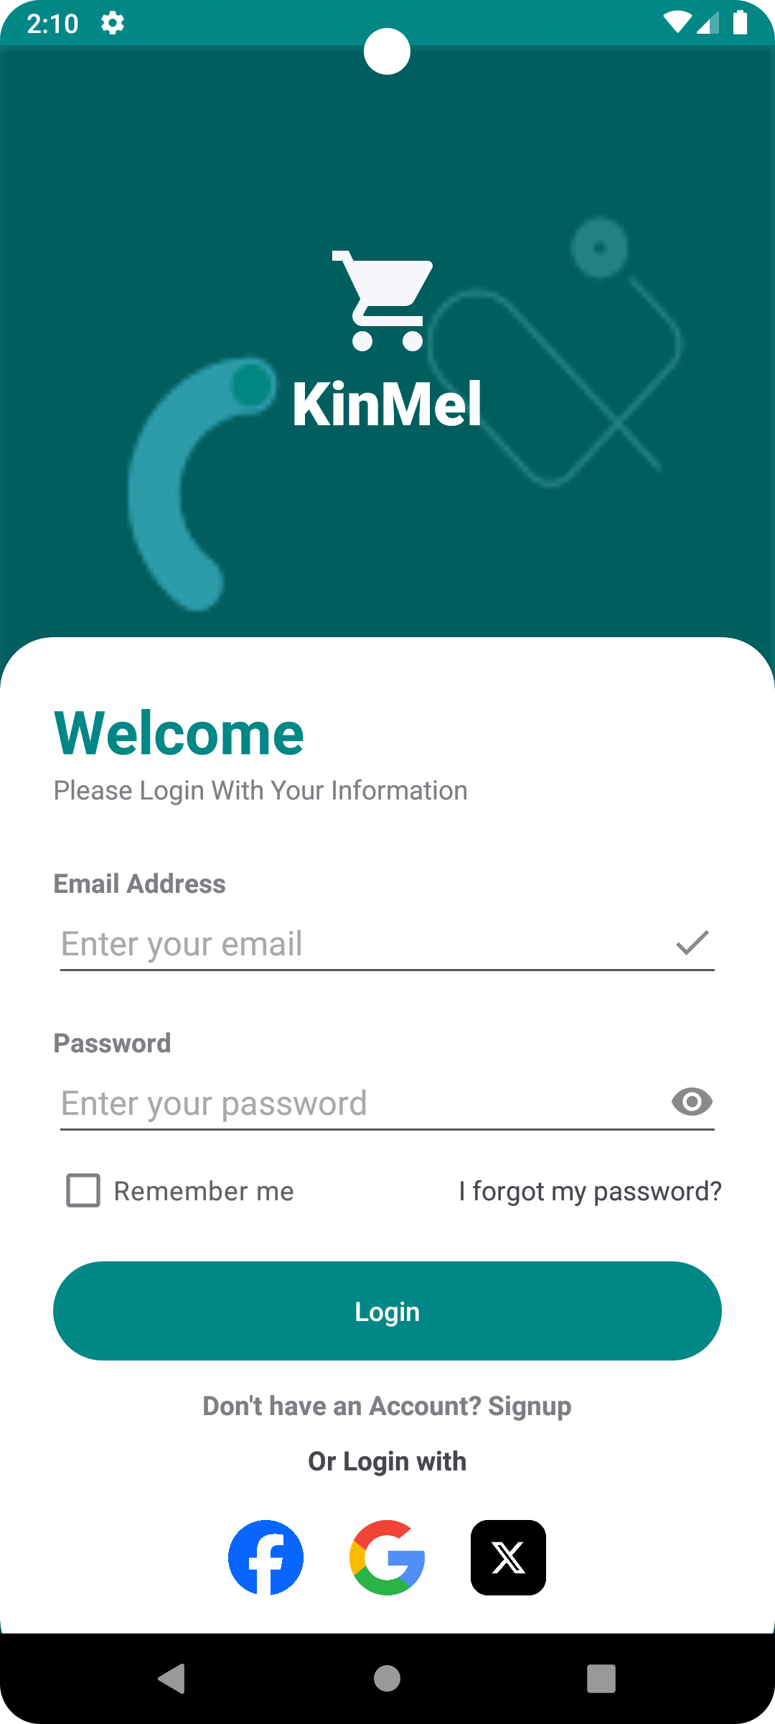
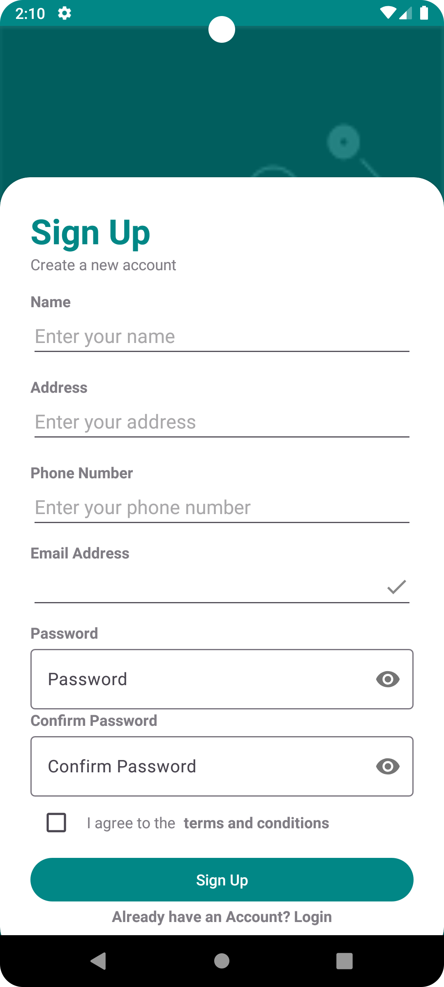
Login
Signup

Slide 23
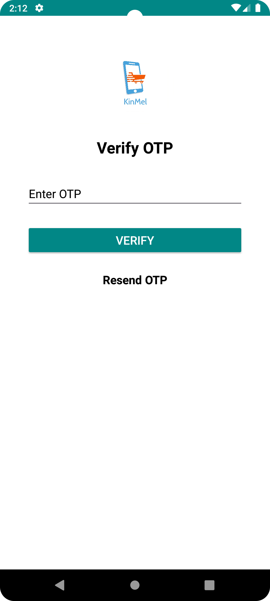
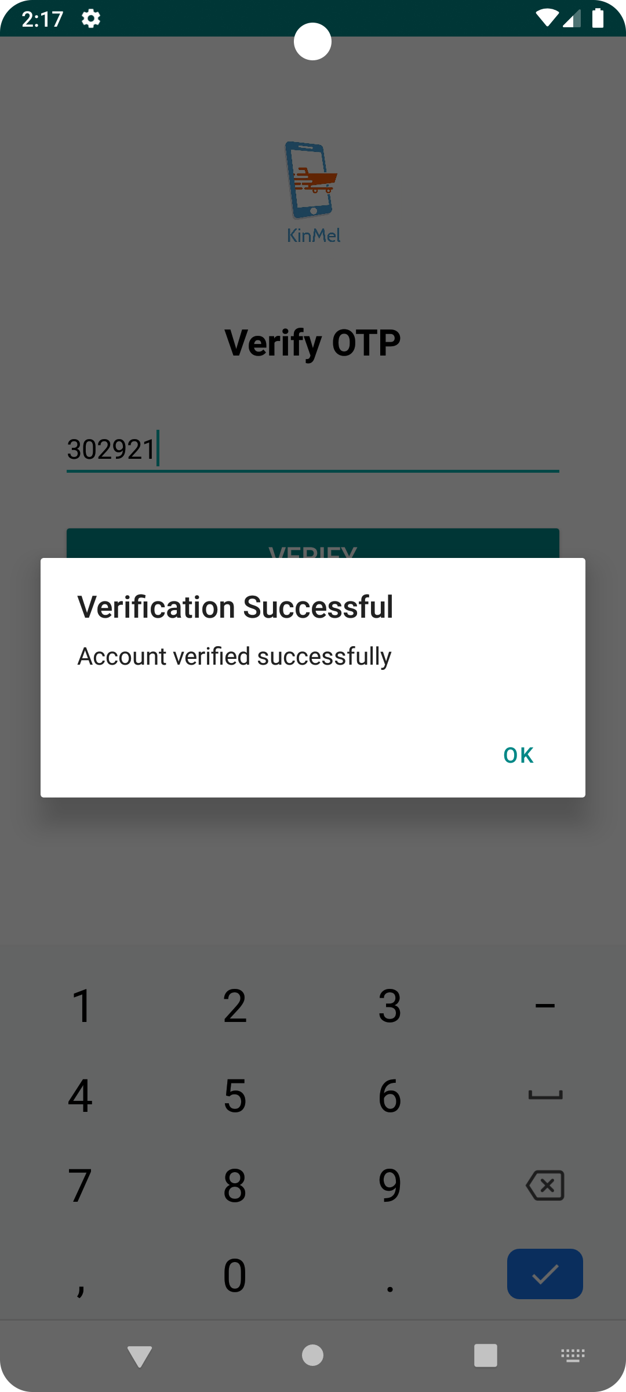
Verify with OTP
Verified

Slide 24
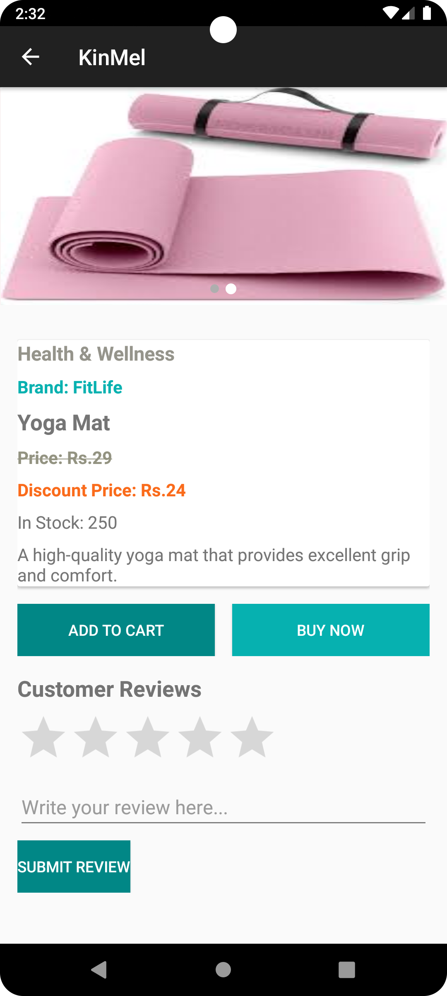
Home Page
Product Page

Slide 25
Thank You!
From KinMel Team

